Slide 1



ACADEMIC WEBFOLIO
Student Name: Rohith N
Register No. and NMID:
AA39E02DAEC6A1E8B594287CE8E367A7
Department: BSc CS with AI
College: College /University S.A.College of Arts and Science/Madras University

Slide 2
PROJECT TITLE
Current Academic Portfolio-A Digital showcase of personal academic records
Developed using:HTML,CSS and JavaScript
Description:
• A personal digital portfolio to present current academic achievements in a structured
and interactive way.
• Provides a centralized platform to view subjects, marks, grades, and progress
visually.
• Ensures easy accessibility of academic records anytime, anywhere.
• Enhances presentation with a clean user interface and responsive design.
• Acts as a digital alternative to traditional academic files and records.
• Serves as a foundation for building a more advanced portfolio system in the future.

Slide 3
AGENDA
1. Problem Statement
2. Project Overview
3. End Users
4. Tools and Technologies
5. Portfolio design and Layout
6. Features and Functionality
7. Results and Screenshots
8. Conclusion
9. Github Link

Slide 4
PROBLEM STATEMENT
Students struggle to showcase their academic profile in a modern, interactive way.
‎
‎Traditional resumes are static, non-interactive, and easily lost.
‎
‎Lack of centralized digital academic showcase.

Slide 5
PROJECT OVERVIEW
‎A web-based student portfolio.
‎Acts as a digital resume with interactive layout.
‎Organized sections: About, Education, Skills, Certificates, Projects, Contact.
‎Provides clean, responsive design accessible anytime.

Slide 6
END USERS
Students – Showcase skills and achievements.
‎Teachers/Mentors – Evaluate academic progress.
‎Recruiters/Employers – Assess profiles for internships & jobs.
‎Peers/Institutions – Share achievements & collaborate.

Slide 7
TOOLS & TECHNOLOGIES
Tools: Visual Studio Code, Web Browser, GitHub
‎Technologies:‎
‎HTML5 – Structure
‎
‎CSS3 – Styling & Animations
‎
‎JavaScript – Interactivity (form validation, alerts)

Slide 8
PORTFOLIO DESIGN & LAYOUT
Header & Navigation – Smooth scrolling links.
‎
‎About Section – Introduction & ambition.
‎
‎Education Section – Academic background.
‎
‎Skills / Certificates / Projects – Card-based layout.
‎
‎Contact Section – Interactive form.
‎
‎Footer – Copyright.

Slide 9
FEATURES & FUNCTIONALITY
Single-page responsive design.
Interactive animations (hover, transitions).
Contact form with JavaScript validation.
Card-based design for Skills, Certificates, Projects.‎
Visually appealing gradients and animations.

Slide 10
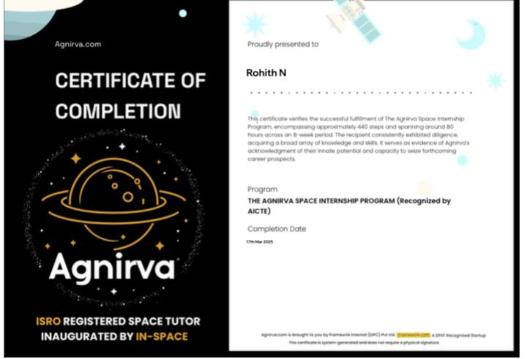

Slide 11
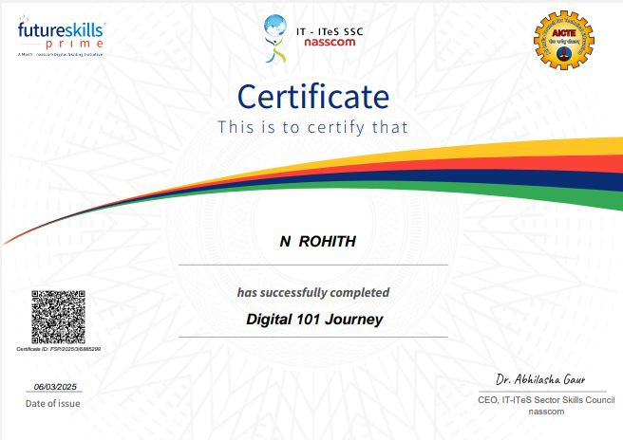

Slide 12
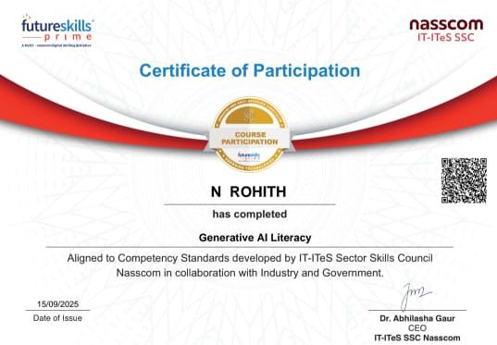

Slide 13
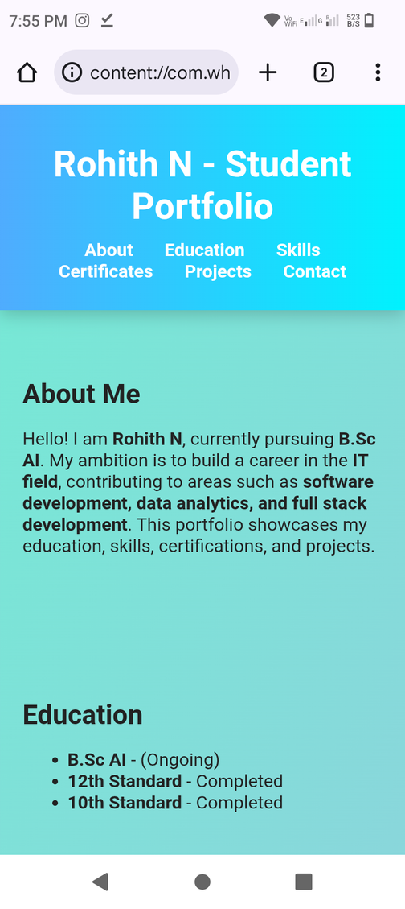
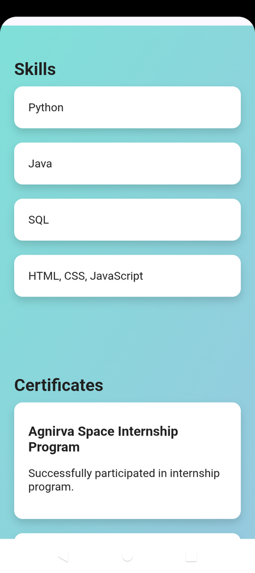
RESULTS AND SCREENSHOTS

Slide 14
CONCLUSION
Provides a modern way for students to showcase themselves.
‎Enhances internship & job opportunities.
‎More effective than traditional resumes.
GitHub Link: https://github.com/rohith-5946

Slide 15
THANK YOU

